Slide 1
Agent Router + Kyverno Authz:
Live Governance for Models and Tools
Deepak Goel, Nutanix | Jim Bugwadia, Nirmata
KyvernoCon | Cloud Native Theater | Tue, Nov 10, 4:30 PM
Notes:
Agent Router was formerly Envoy AI Gateway. The public project name changes; the deployment's API group, CLI and container names remain unchanged. The supplied speaker and event details are preserved, not independently verified.

Slide 2


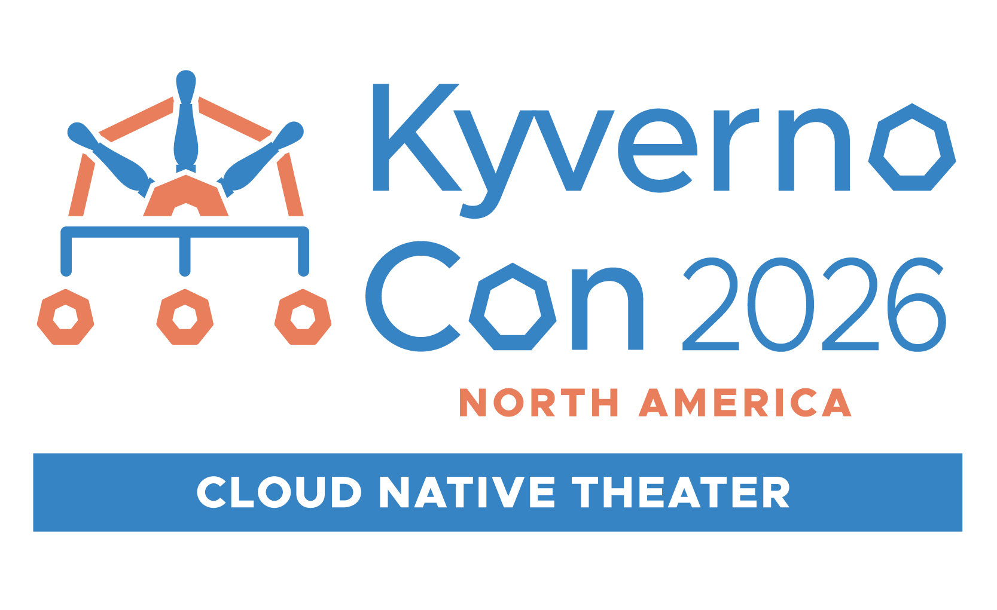
Who we are
Deepak Goel
CTO, Cloud Native
Nutanix
Jim Bugwadia
Co-founder and CEO
Nirmata
Notes:
20 seconds each. Jim: co-creator and maintainer of Kyverno; co-chair of the Kubernetes Policy and Multi-Tenancy Working Groups. Deepak: leads cloud native strategy at Nutanix; helped create KUDO (CNCF).

Slide 3
Your agent needs a router
Start with Agent Router: one integration for models and tools
Without a shared router
With Agent Router
Provider SDKs and formats
Credentials in applications
Retries and fallback logic
Separate MCP integrations
A familiar model API and MCP endpoint
Platform-managed credentials
Declarative routes and failover
Central limits and telemetry
3
Notes:
Original summary of Ignasi Barrera's 'Your Agents Need a Router' talk. The agent should own reasoning; the platform owns traffic operations. Sources: https://github.com/theagentrouter/agent-router and the supplied Sched PDF.

Slide 4
Agent Router controls; Envoy carries
Open source, powered by Envoy and Envoy Gateway
Agent Router declares intent
Envoy carries traffic
Logical models and provider mapping
MCP server aggregation
Routes and backend credentials
Quotas and usage attribution
Request routing and retries
Authentication and rate limits
Circuit breaking and telemetry
Extension points for policy
4
Notes:
Formerly Envoy AI Gateway; now an Agentic AI Foundation project. CRDs such as AIGatewayRoute and MCPRoute still use aigateway.envoyproxy.io. These platform features are not Kyverno Authz features.

Slide 5
One contract, more models and tools
Keep provider and tool integration logic out of the agent
Models: /v1
Tools: /mcp
Use an OpenAI-compatible client
Request a logical model name
Map to provider-specific models
Keep provider keys behind the router
Connect to one MCP endpoint
Aggregate multiple MCP servers
Select exposed tools per route
Authenticate and authorize calls
5
Notes:
Summarizes the supplied Agent Router talk; no provider failover or quota demonstration is claimed for the local Kyverno demo.

Slide 6
Native governance is already valuable
Kyverno Authz extends the platform; it does not replace it
Already built in
The next requirements
JWT authentication
Static MCP tool selection
MCP CEL request allow/deny
Quotas, limits and access telemetry
Use current Kubernetes permissions
Change a response per user
Govern model request bodies
Manage exceptions and policy reports
6
Notes:
Native MCP CEL can inspect claims, tools and arguments. Its limitation for this demo is not CEL itself: it is the available inputs, external lookups and allow/deny output contract. Native behavior was checked against demo v1.2.0.

Slide 7
Kyverno Authz: live policy at the gateway
Authorize business intent with reusable CEL policies
Request authorization
Response governance
ext_authz: allow or deny
Read MCP and model request bodies
Call Kubernetes SubjectAccessReview
Inject verified identity headers
ext_proc prototype: inspect and rewrite
Filter MCP tools/list per user
Keep execution authorization in place
Independent policy service lifecycle
7
Notes:
ext_authz is the existing authorization integration. EnvoyProcessor mode and the :9083 ext_proc listener are local prototype additions, not claimed as a released upstream capability. Discovery is UX, not an authorization boundary.

Slide 8
Native checks vs. Kyverno Authz
Use the simplest control that satisfies the requirement
Tool allowlists + replica bounds
Native MCP CEL can do this
Current Kubernetes RBAC
Kyverno Authz: live SAR lookup
Per-user tools/list response
Kyverno Authz: ext_proc prototype
Model-body checks + tenant header
Kyverno Authz: ext_authz policy
Exceptions + decision reports
Kyverno Authz lifecycle and OpenReports
Kyverno admission is complementary platform governance, not runtime Authz.
8
Notes:
AIGatewayRoute in demo v1.2.0 has no MCP-style CEL authorization. Token ceilings are per-request guardrails, not spend accounting or native quota replacement.

Slide 9
Reference architecture
Agent Router routes; Kyverno Authz evaluates; Envoy enforces
Agent / client
Agent Router + Envoy
Models + MCP
Keycloak JWT
/v1 and /mcp
JWT authentication
Routing and MCP aggregation
Model backend
kube-tools / runbooks
Kyverno Authz
Live SAR -> Kubernetes RBAC
Decisions -> OpenReports
ext_authz :9081 | ext_proc :9083
Kyverno admission + cleanup govern routes and the exception carrier.
9
Notes:
MCP JWT validation and ext_authz run before the user ext_proc filter. The user ext_proc attaches to generated HTTPRoute ai-eg-mcp-main-operations, before the MCP proxy upstream; it receives the aggregated response. Do not describe fictitious x-mcp-tool or x-mcp-op headers: policies parse JSON-RPC bodies. For model traffic a SecurityPolicy targets HTTPRoute models.

Slide 10
Use case: recover checkout safely
A deterministic operations agent workflow on local Kubernetes
Actors and resources
Questions policy must answer
Alice: team-a-dev / checkout
Bob: team-b-dev / checkout
Tools: status, events, logs, scale
Scale is bounded to 1-3 replicas
Can this user act right now?
Should this tool be discoverable?
Is this model request acceptable?
Is emergency access scoped + recorded?
10
Notes:
The demo uses real Keycloak tokens, MCP sessions, SAR requests and deployment updates. The model backend is deterministic and OpenAI-compatible; no actual LLM reasoning, provider spend or agent autonomy is tested.

Slide 11
Demo: seven verified scenarios
Local Kind cluster: kyverno-agentrouter
1 Live RBAC + tool discovery
5 OpenReports decisions
2 Shared request guardrails
6 Complementary admission
3 Model request governance
7 Fail-closed integration
4 Incident-scoped exception
All seven scenarios passed on October 19, 2026; not rerun for this deck.
11
Notes:
From the repo root: ./examples/agentrouter/scripts/setup.sh ; ./examples/agentrouter/scripts/run.sh ; ./examples/agentrouter/scripts/run.sh --check . The updated deck reflects the verified run in this session, not a fresh cluster test today.

Slide 12
Demo 1: same token; different live permissions
The strongest moment: discovery AND execution follow current RBAC
RBAC revoked: Alice -> 4 tools; scale hidden
Direct scale: HTTP 403; no backend execution
Bob: 5 tools; normal access preserved
RBAC restored: Alice -> 5 tools; scale visible
Same JWT and MCP session; scale succeeds
No new token. No Agent Router route change. A live SAR changes the decision.
12
Notes:
Scenario 1 in client/demo.py revokes and restores alice-scale RoleBinding. The discovery response filters kube-tools__scale_deployment when SAR denies. Tools/list is a single-message SSE response; prototype preserves event framing. Direct tools/call authorization remains authoritative even if a client caches tools.

Slide 13
How the policies see intent
Use the real JSON-RPC body, verified identity and live Kubernetes state
Request policy: Envoy mode
Processor policy: prototype
JWT -> preferred_username
JSON-RPC -> method / tool / args
SAR -> current resource permission
Return envoy.Allowed / Denied
Response phase + tools/list request
Single SSE data payload -> JSON
SAR -> filter result.tools
extproc.ReplaceBody -> reframe SSE
13
Notes:
Source files: examples/agentrouter/policies/authz/mcp-operations.yaml and policies/processor/mcp-tool-discovery.yaml. The slide is a policy flow summary, not deployable YAML. There are no invented intent headers.

Slide 14
Demo 2-3: one language for tools and models
Be honest: some request checks are possible with native MCP CEL
Tool guardrails
Model-body governance
Exact workload + namespace
Known tools and arguments
Integer replica count: 1-3
Reject before backend execution
Alice: demo-mini; Bob: demo-pro
Bound max_tokens; n must be 1
Restrict function calling
Block credential patterns in prompts
14
Notes:
llm-models.yaml also replaces a spoofed x-tenant-id with the verified username. The backend audit confirms denied calls never reach the model. Regex matching is a limited credential guardrail, not comprehensive DLP or prompt-injection prevention. Request token ceilings do not replace Agent Router token quotas.

Slide 15
Demo 4: scoped incident access
Bob recovers team A only within the INC-1234 exception
No exception: cross-team scale -> DENY
Activate + reload: Bob + INC-1234 -> ALLOW
No incident header: DENY
Wrong user / tool: DENY
Replicas out of bounds: DENY
Revoke + reload: cross-team scale -> DENY
The exception skips the whole policy, including SAR: scope every condition.
15
Notes:
PolicyException source: policies/exceptions/break-glass-inc-1234.yaml. Verified Bob, POST tools/call, exact tool, team-a-dev/checkout, x-incident-id INC-1234, integer replicas 1-3 and no additional arguments. The demo creates a governed ConfigMap carrier with request-time expiry; activating/revoking requires rolling the authorizer because file sources are startup-only. This is not native Kubernetes-sourced hot reload in the coexistence demo.

Slide 16
Manage exceptions, not just bypasses
Govern the exception carrier and retain a hard request-time expiry
Complementary admission
Runtime + lifecycle
Require incident metadata
Require narrow exception scope
Restrict referenced policy names
Cap configured TTL at one hour
15-minute demo expiry
Cleanup deletes the ConfigMap
Explicit rollout loads / revokes
Expired requests stop matching
16
Notes:
Kyverno admission validates the ConfigMap carrier; the embedded Envoy PolicyException is file-loaded, not submitted as a native API object. TTL deletion alone does not remove an already loaded exception; the added request-time expiry is essential. No human approval workflow is implemented.

Slide 17
Demo 5: report decisions, not credentials
OpenReports connects a request to the policy that decided
RESULT | fail | agentrouter-bounded-operations
RESULT | pass | agentrouter-model-governance
RESULT | pass | (default allow) [exception]
Source: kyverno-authz
Properties: status, reason, method, path, host
Sensitive headers: [REDACTED]; bodies omitted
Exception passes are unattributed; ext_proc decisions are not reported yet.
17
Notes:
Illustrative abbreviated report view, based on the tested result schema. The model policy's actual metadata name is checked by the generation validation. ReportResult.Description serializes as message; correlate with x-demo-id. OpenReports subscribers use --openreports-enabled --report-flush-interval=2s. The demo asserts pass/fail, both policy names and absence of bearer tokens. Prior per-pod reports remain; reports are not a tamper-proof audit system.

Slide 18
Demo 6-7: platform guards + fail closed
Separate Kyverno admission from runtime Kyverno Authz
Kyverno admission + cleanup
Envoy + Kyverno Authz
Reject unguarded routes
Require JWT + body forwarding
Reject fail-open / inline secrets
Govern exception carrier metadata
Reject bad or missing tokens
Reject malformed / oversized bodies
Deny before backend execution
Fail closed on authorizer outage
18
Notes:
Authentication, body limits and ext_authz fail-closed behavior are Envoy capabilities, not unique Kyverno Authz features. The demo verifies composition with policy evaluation and backend/state assertions.

Slide 19
Run it locally
No cloud model credentials required
./examples/agentrouter/scripts/setup.sh
./examples/agentrouter/scripts/run.sh
./examples/agentrouter/scripts/run.sh --check
./examples/agentrouter/scripts/reset.sh
Real gateway, JWTs, MCP sessions, Kubernetes RBAC and deployment changes.
Deterministic MCP/model backends make the results repeatable.
19
Notes:
Verified environment: Kind Kubernetes v1.35.1, Envoy Gateway v1.9.2, Agent Router v1.2.0, Kyverno v1.19.1 (chart 3.9.1), Keycloak 26.3.3. Dependencies: Docker, kind, kubectl, helm, Go, ko, Python. setup targets kind-kyverno-agentrouter explicitly and builds Kyverno Authz from the local source checkout. The demo code is uncommitted.

Slide 20
Prototype limits and deployment gaps
A working demo is not production readiness
Processing + reporting
Policy deployment
ext_proc is a local prototype
Buffered bodies add latency + memory
Compressed / multi-chunk bypass
No ext_proc decision reports yet
Kyverno self-validation conflicts
File policy + exception fallback
Exception reload rolls authorizer
No automated approval workflow
20
Notes:
Multi-event SSE replacement fails closed; indefinite streams are not suitable for fully buffered processing. Kyverno v1.19.1 self-validation rejects Envoy CEL functions and variable-based exceptions. No webhook interception is used. File loading at startup is explicitly documented. Prompt patterns are not full DLP; the demo does not validate real LLM behavior.

Slide 21
Route once; govern with live context
A complementary stack, not a replacement gateway
Agent Router
Kyverno Authz
One integration for models and tools
Keep secrets behind the router
Declare routing and capacity intent
Envoy enforces the traffic path
Authorize with live external state
Govern requests and responses
Reuse versioned CEL policies
Manage exceptions + decision reports
21
Notes:
The principal differentiator is live context plus response policy, not simple tool allowlists. Keep released ext_authz and prototype ext_proc separate when discussing roadmap or production adoption.

Slide 22
References and demo sources
Agent Router foundation; Kyverno Authz complementary policy
Agent Router project + documentation
https://github.com/theagentrouter/agent-router
Your Agents Need a Router - Ignasi Barrera
https://agntconmcpconeu26.sched.com/event/2WF5u
Demo guide + policy sources
examples/agentrouter/README.md
Implementation: ext_authz + ext_proc prototype
pkg/authz/envoy/ and pkg/authz/extproc/
22
Notes:
Agent Router material is original summary, not copied slides. Full reference PDF: https://hosted-files.sched.co/agntconmcpconeu26/e1/Your%20Agents%20Need%20a%20Router_%20One%20Integration%20for%20Every%20Model%20and%20Tool.pdf . External project sources reviewed October 26, 2026. Local demo validated October 19.

